Slide 1
Welcome: MMDPUG Meetup
Dennes Torres

Slide 2
Today
Building a Scalable Data Intelligence Platform
Unlocking Marketing Intelligence with AI Transformations in Fabric

Slide 3
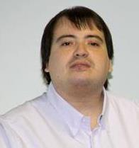






Dennes Torres Data Platform MVP (Alumni)
Dtower Software
https://dtowersoftware.com
Trainer
MCT, Azure Solutions Architect, Azure Data Engineer and Azure DevOps Engineer
Malta Data Platform UG Leader
Malta
MMDPUG
https://www.facebook.com/MMDPUG
http://dennestorres.com
Dennes.Torres
@Dennes
https://br.linkedin.com/in/dennestorres
dennes@bufaloinfo.com.br
http://youtube.com/c/dennestorres

Slide 4


Slide 5
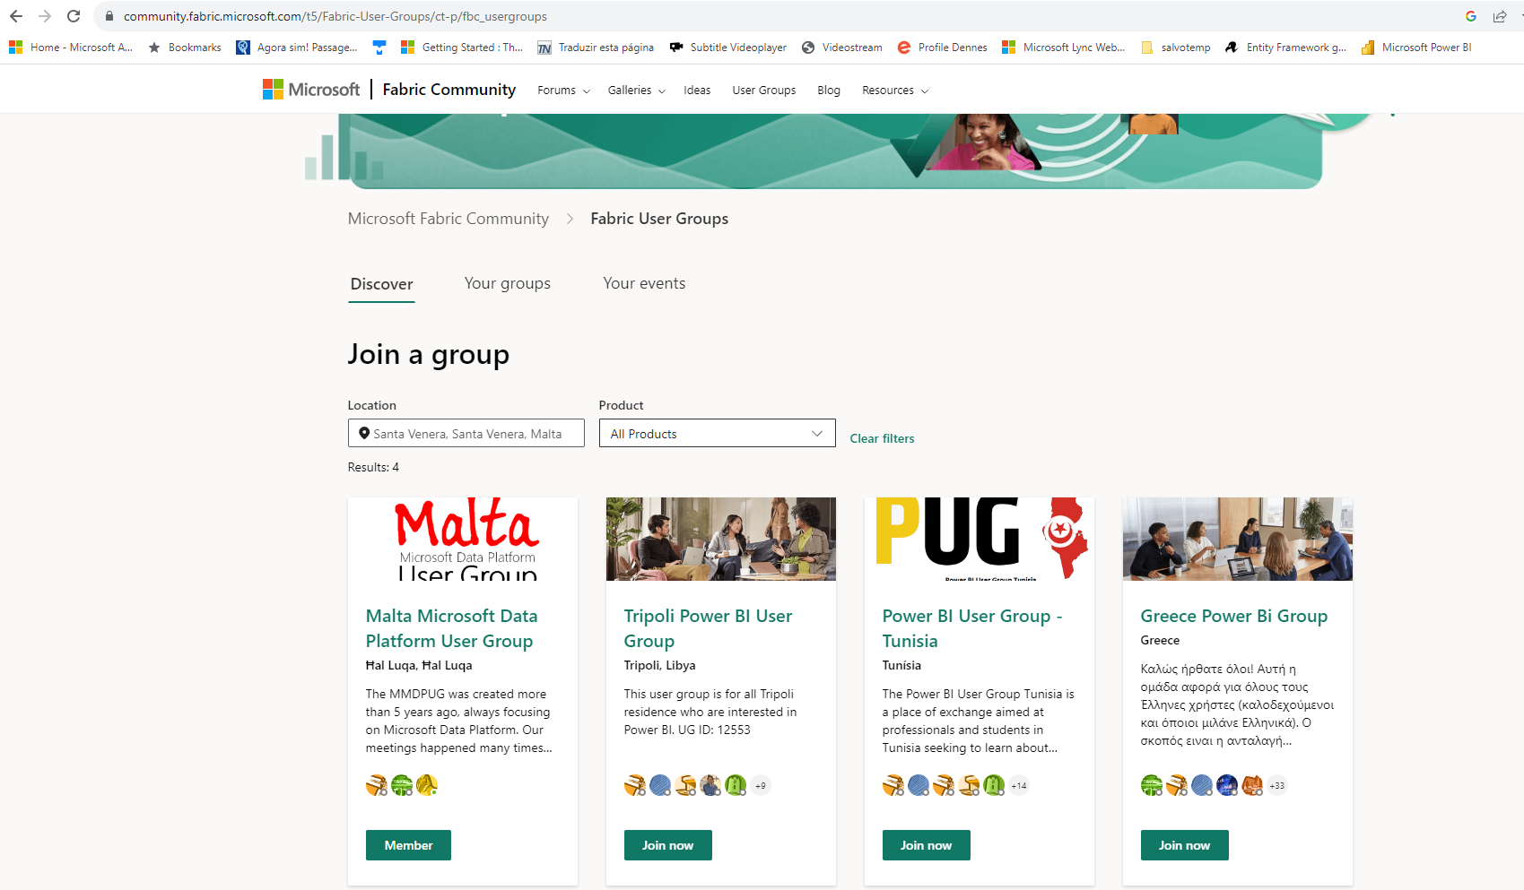

Slide 6
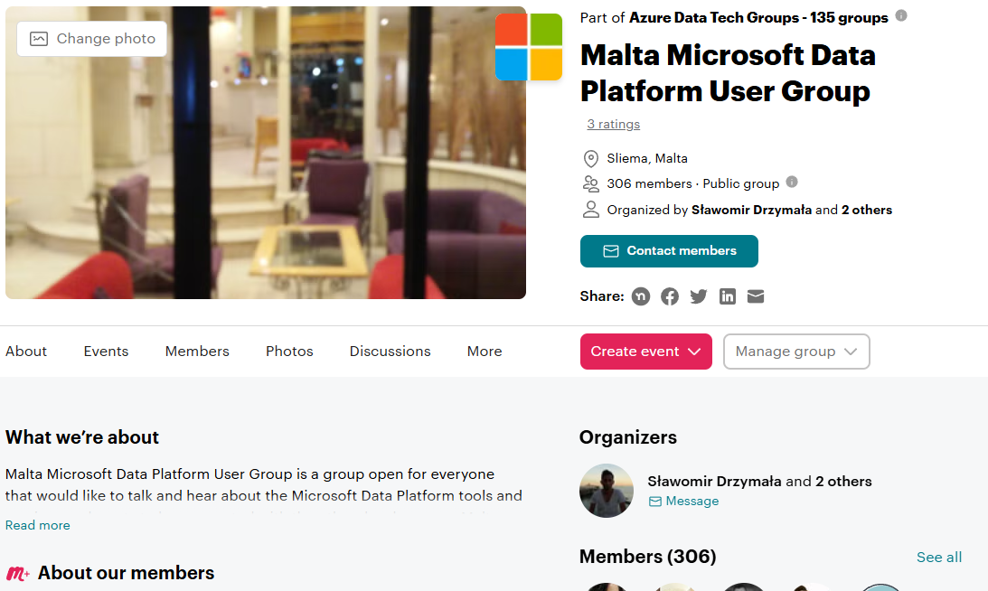

Slide 7
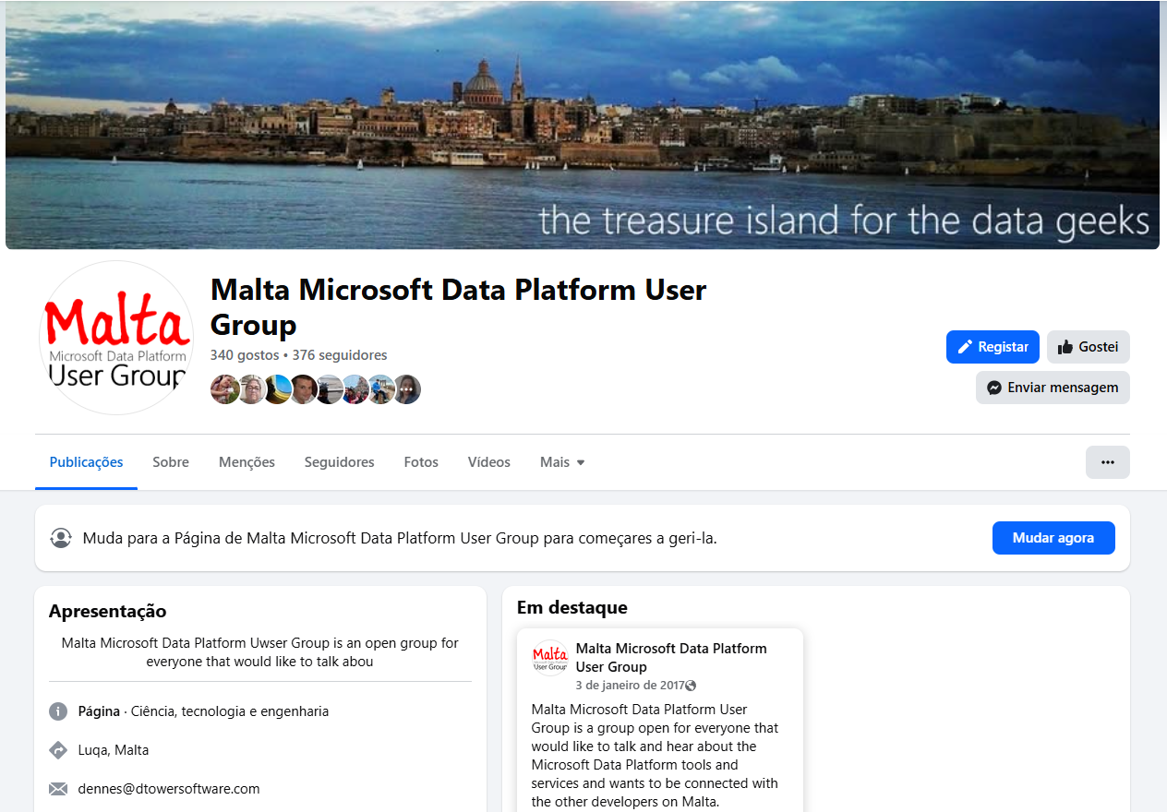

Slide 8
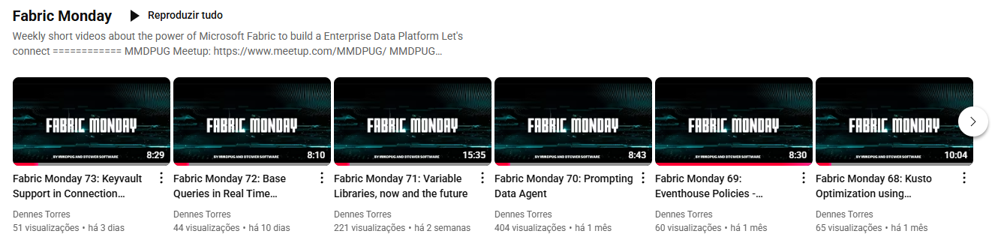
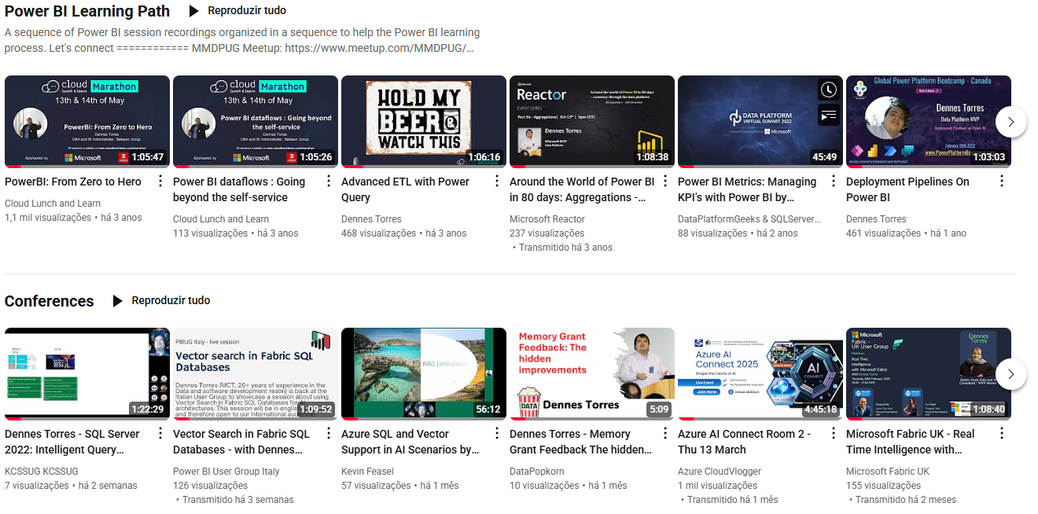

Slide 9
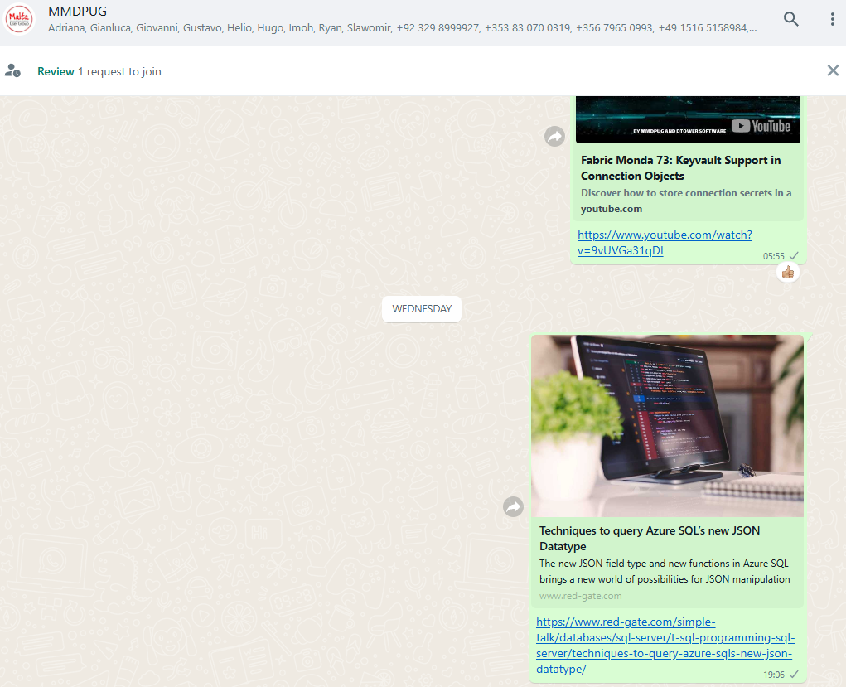

Slide 10
How to reach us
Facebook Page
https://tinyurl.com/MMDPUGPAGE
Facebook Group
https://tinyurl.com/MMDPUGGROUP
WhatsApp
https://tinyurl.com/MMDPUGCHAT
Meetup
https://www.meetup.com/MMDPUG/
Twitter
http://twitter.com/Dennes
Fabric Community
https://tinyurl.com/2674jzuc

Slide 11
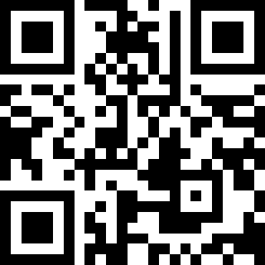
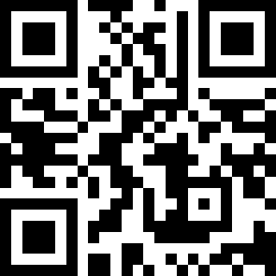
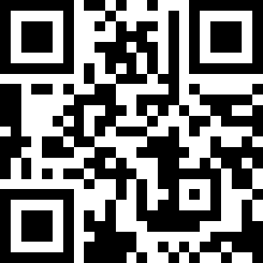
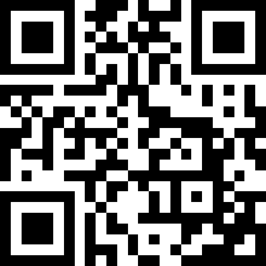
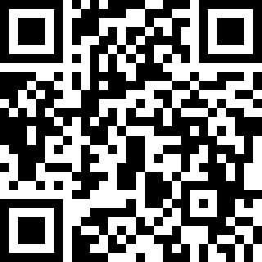
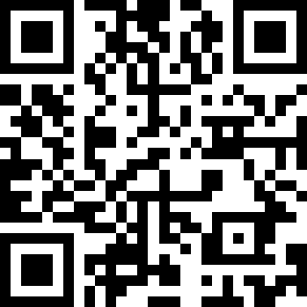
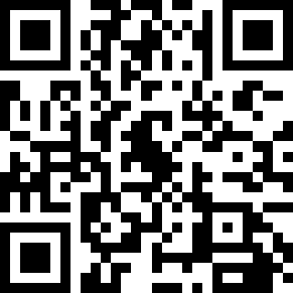
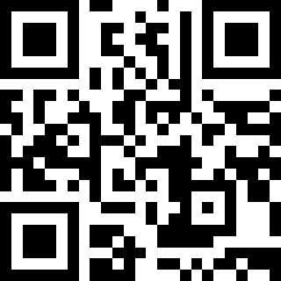
Fabric Community
Facebook Page
Facebook Group
WhatsApp
Meetup
LinkedIn
Youtube
Twitter

Slide 12
Tell about your experience on linkedin and social medias

